Slide 1


Introduction to (AGAR) Assertion 10 Digital & Data Compliance
(Breakthrough Communications, 2025)

Slide 2

What is it?
It is a completely new standalone assertion introduced in the 2025 Practitioners Guide for smaller authorities
(Northantscalc, 2025)

Slide 3

When does it apply
(Solver from Solvers, no date)
It applies to the Annual Governance and Accountability Returns (AGAR) for the financial year 1st April 2025, so now.

Slide 4

Why is it important?
(11star, no date)
Councils must now demonstrate real compliance to digital matters such as GDPR, not just good intentions

Slide 5
What must Councils do to tick Assertion 10?
  Email management - Every authority must have a generic email account hosted on an authority owned domain, for example clerk@abcparishcouncil.gov.uk or clerk@abcparishcouncil.org.uk rather than abcparishclerk@gmail.com or abcparishclerk@outlook.com for example
  All smaller authorities (excluding parish meetings) must meet legal requirements for all existing websites regardless of what domain is being used.
  All websites must meet the Web Content Accessibility Guidelines 2.2AA and the Public Sector Bodies (Websites and Mobile Applications) (No. 2) Accessibility Regulations 2018
  All websites must include published documentation as specified in the Freedom of Information Act 2000 and the Transparency Code for Smaller Authorities (where applicable)
  All smaller authorities, including parish meetings, must follow both the General Data Protection Regulation (GDPR) 2016 and the Data Protection Act (DPA) 2018
  All smaller authorities, including parish meetings, must process personal data with care in line with the principles of data protection.
  The DPA 2018 supplements the GDPR and classifies an authority as both a Data Controller and a Data Processor.
  All smaller authorities (excluding parish meetings) must also have an IT policy. This explains how everyone - clerks, members and other staff - should conduct authority business in a secure and legal way when using IT equipment and software. This relates to the use of authority-owned and personal equipment.

Slide 6

Email Management
Every authority must have a generic email account hosted on an authority owned domain, for example clerk@abcparishcouncil.gov.uk or clerk@abcparishcouncil.org.uk rather than abcparishclerk@gmail.com or abcparishclerk@outlook.com for example
(National Government, 2025)

Slide 7

(EagletSolutions)
The Council already has an authority owned domain with dedicated councilor and staff emails

Slide 8

Accessible & Compliant Website
(Yushkevych, 2023)
All smaller authorities (excluding parish meetings) must meet legal requirements for all existing websites regardless of what domain is being used. All websites must meet the Web Content Accessibility Guidelines 2.2AA and the Public Sector Bodies (Websites and Mobile Applications) (No. 2) Accessibility Regulations 2018All websites must include published documentation as specified in the Freedom of Information Act 2000 and the Transparency Code for Smaller Authorities (where applicable)

Slide 9

The council website currently meets 2.1 AA standard (accessibility statement on the website) and publishes required FOI and Transparency Code Documents.
Further work is required on the website.
(NeilJB, no date)

Slide 10

Personal Data
(Warchi, no date)
All smaller authorities, including parish meetings, must process personal data with care and in line with the principles of data protection

Slide 11
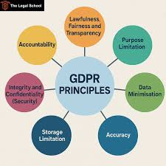
Seven principles of GDPR are:
Lawfulness, fairness and transparency
Purpose Limitation
Data minimisation
Accuracy
Storage Limitation
Integrity and Confidentiality
Accountability
(The Legal School, no date)

Slide 12
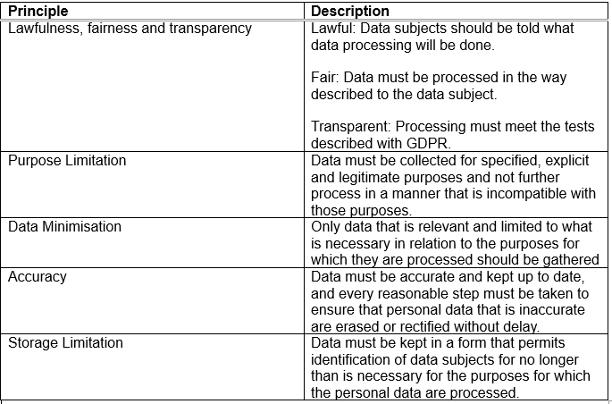

Slide 13
(EagletSolutions)
The Council is registered with the Information Commissioners Office (ICO). The principles are all covered within the various GDPR policies, some are being readopted and some are new.

Slide 14

Who is the Data Controller and Data Processor
(Qureshi, 2023)

Slide 15

Data Controller - Natural or legal person, public authority, agency or other body which, alone or jointly with others, determines the purposes and means of processing of personal data.
Data Processors - Process personal data on behalf of the controller.
(Noonan, 2025)

Slide 16
(EagletSolutions)
The Council fills both these roles and is registered with the Information Commissioners Office (ICO).

Slide 17

IT policy
All smaller authorities (excluding parish meetings) must also have an IT policy. This explains how everyone - clerks, members and other staff - should conduct authority business in a secure and legal way when using IT equipment and software. This relates to the use of authority-owned and personal equipment.
(dsparks, 2018)

Slide 18
(EagletSolutions)
New policies to be implemented and approved by the Council

Slide 19

(Wade Buttons Inc)
Any Questions before we move onto the policies?

