Slide 1
Next Shropshire Local Plan
‘Scoping’ Consultation
Agenda
Intention to commence plan-making
Timetable
‘Scoping’ consultation
- Draft site assessment methodology
- Draft community hierarchy
The agenda reflects the Cabinet decision of 6 May 2026.

Slide 2
Toward our next Local Plan
Sustainable Growth - Flourishing Shropshire
Intention to Commence Plan-Making
Shropshire Council issued an intention to commence preparation of the next Shropshire Local Plan on 8 May 2026.
The Local Plan is to be progressed under Government’s new plan-making system, which involves a 30-month preparation period (plus minimum 4-month scoping stage).
Plan-Making Timetable
A plan-making timetable and associated project initiation document have been published outlining anticipated timescales & processes for preparing the Local Plan.
The timetable also addresses:
The next Policy Map.
An updated CIL Charging Schedule.

Slide 3
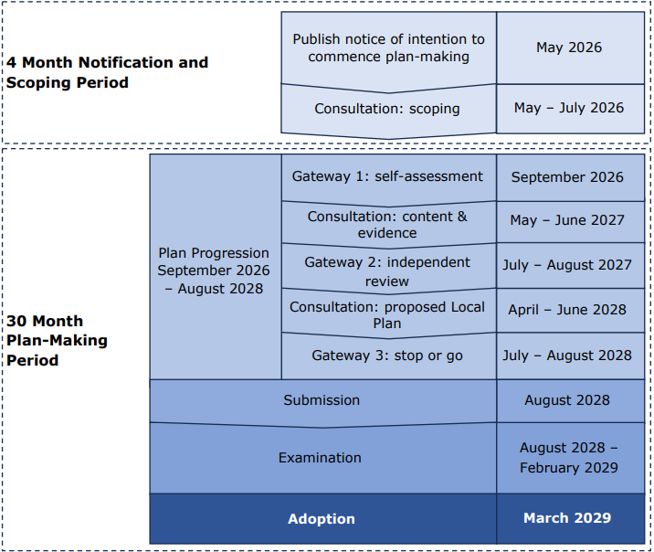
Toward our next Local Plan
Sustainable Growth - Flourishing Shropshire
Next Shropshire Local Plan Timetable

Slide 4
Toward our next Local Plan
Local Plan Examination
The examination of the draft Local Plan will be undertaken by Planning Inspector(or panel of Inspectors) appointed by the Secretary of State.
The purpose of the examination is to assess whether the plan is ‘sound’. A sound plan should satisfy the following tests:
A) Positive – the plan sets a positive approach to delivering growth to meet development needs of the area.
B) Appropriate – the plan sets out an appropriate strategy to enable delivery of sustainable development (taking account of reasonable alternatives).
C) Realistic – the plan sets realistic policies for development, is based on effective cross-boundary working on strategic matters, and there is a reasonable prospect site allocations are capable of delivery at the time envisioned.
D) Consistent – the plan accords with policies for plan-making in national planning policy and does not duplicate, substantively restate or modify national decision-making policies.
E) Conformity – the plans in general conformity with any adopted SDS for the area.
The examination will provide an opportunity for those with concerns about plan ‘soundness’ to present their concerns to the Planning Inspector.
Sustainable Growth - Flourishing Shropshire

Slide 5
Toward our next Local Plan
Sustainable Growth - Flourishing Shropshire
Local Plan ‘Scoping’ Consultation
The 'scoping’ consultation runs from 20 May 2026 – 15 July 2026.
The consultation focuses on what the Local Plan should contain and our approach to engagement during its preparation.
Views are sought on:
Key priorities for the Local Plan vision (aspiration for how an area will change).
Determining measurable outcomes (monitoring indicators).
Key considerations for the Local Plan spatial strategy (level & distribution of growth).
The approach to identifying and assessing potential site allocations.
The local issues to be addressed by planning policies.
How we can effectively engage during plan-making.
Evidence required to support the Local Plan.
No growth options or site allocations proposed at this stage.

Slide 6
Toward our next Local Plan
Sustainable Growth - Flourishing Shropshire
‘Scoping’ the Vision and Measurable Outcomes
The consultation document identifies various considerations we believe of relevance to the Local Plan’s vision and measurable outcomes - informed by a review of the local / national context and a ‘SWOT’ analysis of Shropshire.
Views are sought on the importance of these considerations and whether other factors should be reflected.
National Policy Considerations:
Delivering sufficient homes and employment
Promoting vitality of town centres.
Protecting and enhancing our environment.
Climate adaption/mitigation and net zero.
Design quality.
Connectivity.
Safeguarding minerals and ensuring a sufficient supply.
Local Considerations:
Infrastructure-led.
Embracing rurality.
Types and tenures of housing (including affordable and specialist housing).
Supporting employers.
Locally responsive design.
Health, inclusivity and nature recovery (LNRS).
Connectivity in a rural context.

Slide 7
Toward our next Local Plan
Sustainable Growth - Flourishing Shropshire
‘Scoping’ the Spatial Strategy
Level of development:
The consultation document:
Confirms the ‘starting point’ for the housing requirement is Local Housing Need calculated using Government’s Standard Method – 2,030 per annum.
Explains the ‘starting point’ for the employment land requirement (local need - to be calculated).
Outlines other key considerations we believe of relevance to the level of development.
Views are sought on the importance of each key consideration and whether there are other factors that should be considered.
The Starting Point
Further Local Considerations
Wider Considerations
All Reasonable Options
Housing
Local housing need
Infrastructure capacity, deliverability, environment, needs of communities and supporting economic growth
Cross-boundary need, consultation responses, technical assessment
Employment
Economic development needs assessment
Balanced growth, infrastructure capacity, deliverability, environment, modernising economy, employer needs
Cross-boundary need, consultation responses, technical assessment

Slide 8
Toward our next Local Plan
Sustainable Growth - Flourishing Shropshire
‘Scoping’ the Spatial Strategy
Distribution of development
Key Principles
a. Enabling increased sustainability of rural communities
b. Supporting the role of our urban communities
c. Facilitating complementary new communities
d. Responding to rurality and function of rural areas
The consultation document outlines key principles and considerations we believe relevant to the distribution of development.
It specifies the proposed ‘starting point’ is a Community Hierarchy.
Views are sought on each principle / consideration (including the Community Hierarchy) and whether other factors should be considered.
Key Considerations
The Starting Point
Community Hierarchy
Grouping communities using consistent criteria on community characteristics.
Other Community Considerations
Infrastructure Capacity
Demand
Constraints
Opportunities
  Locations to be conserved:
  The consultation document proposes alignment with the Shropshire Local Nature Recovery Strategy.
  Views are sought on the factors to consider when identifying locations to conserve.
Wider Considerations
‘Scoping’ Consultation
Material issues raised in responses
Technical Assessment
Directly informing preparation and assessment of reasonable options.
All Reasonable Options

Slide 9
Toward our next Local Plan
Sustainable Growth - Flourishing Shropshire
‘Scoping’ the Assessment of Sites
The consultation document indicates allocations are likely to be identified for:
  Residential (including affordable and specialist housing).
  Gypsy & traveller pitches.
  Employment (include waste).
  Retail and leisure.
Views are sort on the need for allocations for each of these purposes.
Views are also sought on whether allocations are necessary for:
  Mineral extraction.
  Renewable energy generation.
  Draft Site Assessment Methodology
A proposed site assessment methodology accompanies the scoping consultation document and views on its suitability are sought through the consultation.
For context, a map of ‘call for sites’ promotions has been published – views on these promotions not sought at this time!
Importantly not all promotions will be allocated for development – the site assessment process will identify proposed allocations, which will be the subject of future consultation.

Slide 10
Toward our next Local Plan
Sustainable Growth - Flourishing Shropshire
‘Scoping’ Local Policies
Government is developing national decision making-policies.
This will allow Local Plan policies to focus on locally specific issues and objectives.
The consultation document identifies potential policy areas for the next Local Plan.
Views are sought on each identified area and whether other areas should be addressed.
Density and design
Climate change and health
Housing mix and affordability
Vitality and viability of town centres
Renewable energy
Infrastructure and open space
Site specific requirements
Minerals
Managing employment and waste facilities
Developer contributions
‘Scoping’ Approach to Engagement and Evidence
The consultation document outlines our proposed approach to engagement during the plan making process, seeking views on its suitability.
The consultation document also outlines the intended evidence base to support the next Local Plan, seeking views on its suitability.

Slide 11
Toward our next Local Plan
Sustainable Growth - Flourishing Shropshire
Draft Community Hierarchy
Categorisation of communities based on an assessment of their characteristics.
The proposed methodology responds to Shropshire’s:
Geography – large, diverse, predominantly rural.
Communities – varied in size, function and identity.
Stage 1: Identification of communities
Stage 2: Analysis of communities
Stage 3: Categorisation of communities
All recognised named settlements considered.
Analysis considers:
Size (resident population and number of dwellings).
Connectivity (maximum ‘overall connectivity score’ of DfT Connectivity Metric.
Seven categories with specific thresholds for inclusion.

Slide 12
Toward our next Local Plan
Sustainable Growth - Flourishing Shropshire
Draft Community Hierarchy
Stage 3: Categorisation
The table summarises the ‘thresholds’ for each community category:
Community Category | Gateway One |  |  |  | Gateway Two
 | Population |  | Dwellings |  | Maximum Connectivity Score
Strategic Centre | 50,000 or more | & |  | 25,000 or more | 75 or more (Band A)
Principal Centre | 8,000 or more | & |  | 4,000 or more | 60 or more (Band A)
Key Centre | 1,500 or more | & |  | 750 or more | 29 or more (Band A)
Primary Connected Village | 700 or more | & |  | 350 or more | 21 or more (Band B or higher)
Secondary Connected Village | 300 or more | & |  | 150 or more | 14 or more (Band D or higher)
Tertiary Connected Village | 150 or more | & |  | 75 or more | 9 or more (Band F or higher)
Other Communities | 149 or less | & |  | 74 or fewer | 8 or less (Band G or lower)

Slide 13
Toward our next Local Plan
Sustainable Growth - Flourishing Shropshire
Draft Community Hierarchy Categories 1-3:
Category 3 | Community
Key Centre | Albrighton
 | Baschurch
 | Bayston Hill
 | Bishop's Castle
 | Broseley
 | Church Stretton
 | Cleobury Mortimer
 | Craven Arms
 | Ellesmere
 | Gobowen
 | Highley
 | Minsterley
 | Much Wenlock
 | Pontesbury
 | St Martins
 | Wem
 | Whittington
Category 1 | Community
Strategic Centre | Shrewsbury
Category 2 | Community
Principal Centre | Bridgnorth
 | Ludlow
 | Market Drayton
 | Oswestry
 | Shifnal
 | Whitchurch
Notes:
1 Strategic Centre
6 Principal Centres
17 Key Centres
15 Primary Connected Villages
31 Secondary Connected Villages
62 Tertiary Connected Villages

Slide 14
Toward our next Local Plan
Sustainable Growth - Flourishing Shropshire
Draft Community Hierarchy Category 4 – Primary Connected Villages:
Community | Place Plan
Alveley | Bridgnorth
Bomere Heath | Shrewsbury
Burford | Ludlow
Cosford (including RAF Cosford) | Albrighton
Cross Houses | Shrewsbury
Dorrington | Shrewsbury
Pant | Oswestry
Prees | Whitchurch
Prees Higher Heath | Whitchurch
Ruyton XI Towns | Oswestry
Shawbury | Wem
Ternhill | Market Drayton
West Felton | Oswestry
Weston Rhyn & Preesgweene | Oswestry
Woore, Ireland's Cross & Pipe Gate | Market Drayton

Slide 15
Toward our next Local Plan
Sustainable Growth - Flourishing Shropshire
Draft Community Hierarchy Category 5 – Secondary Connected Villages:
Community | Place Plan
Bucknell | Bishop's Castle
Cheswardine | Market Drayton
Chirk Bank | Oswestry
Claverley | Bridgnorth
Clee Hill | Ludlow
Clive | Wem
Clun | Bishop's Castle
Cockshutt | Ellesmere
Condover | Shrewsbury
Cressage | Much Wenlock
Ditton Priors | Bridgnorth
Dudleston Heath | Ellesmere
Eardington | Bridgnorth
Ford | Shrewsbury
Hadnall | Wem
Hanwood | Shrewsbury
Hanwood Bank | Shrewsbury
Harmer Hill | Wem
Community | Place Plan
Hinstock | Market Drayton
Hodnet | Market Drayton
Knowbury | Ludlow
Llanymynech | Oswestry
Montford Bridge | Shrewsbury
Myddle | Wem
Nesscliffe | Shrewsbury
Park Hall | Oswestry
Quatford | Bridgnorth
Tilstock | Whitchurch
Trefonen | Oswestry
Westbury | Shrewsbury
Worthen & Brockton | Bishop's Castle

Slide 16
Toward our next Local Plan
Sustainable Growth - Flourishing Shropshire
Draft Community Hierarchy Category 6 – Tertiary Connected Villages:
Community | Place Plan
Ackleton | Bridgnorth
Acton Burnell | Church Stretton
Adderley | Market Drayton
All Stretton | Church Stretton
Angel Bank & Farden | Ludlow
Annscroft | Shrewsbury
Ashford Carbonell | Ludlow
Aston-On-Clun | Craven Arms
Beckbury | Albrighton
Bicton | Shrewsbury
Chelmarsh | Highley
Child's Ercall | Market Drayton
Chirbury | Bishop's Castle
Clungunford & Abcott | Bishop's Castle
Crickmery & Wistanswick | Market Drayton
Diddlebury | Craven Arms
Doddington | Cleobury Mortimer
Forton Heath & Mytton | Shrewsbury
Four Crosses, Shepherds Lane & Calcott | Shrewsbury
Grinshill | Wem
Community | Place Plan
Halfway House | Shrewsbury
Hampton Loade | Bridgnorth
Hilton | Bridgnorth
Homer | Much Wenlock
Ightfield | Whitchurch
Kemberton | Shifnal
Kinnerley | Oswestry
Knockin | Oswestry
Knockin Heath, Dovaston & Dovaston Bank | Oswestry
Little Stretton | Church Stretton
Llynclys | Oswestry
Longden | Shrewsbury
Longnor | Church Stretton
Loppington | Wem
Lydbury North | Bishop's Castle
Lyth Bank & Lyth Hill | Shrewsbury
Maesbury | Oswestry
Maesbury Marsh | Oswestry
Marchamley | Market Drayton
Newcastle on Clun | Bishop's Castle
Norton In Hales | Market Drayton
Oldbury | Bridgnorth
Community | Place Plan
Oreton | Cleobury Mortimer
Perthy & Welsh Frankton | Ellesmere
Pontesbury Hill | Minsterley & Pontesbury
Prees Heath | Whitchurch
Rhoswiel | Oswestry
Sheriffhales | Shifnal
Snailbeach | Bishop's Castle
Stanton Upon Hine Heath | Wem
Stoke Heath | Market Drayton
Stottesdon | Cleobury Mortimer
Tetchill | Ellesmere
The Hobbins | Bridgnorth
The Sheet | Ludlow
Treflach | Oswestry
Upton Magna | Shrewsbury
Walford Heath & Oldwood | Shrewsbury
Welshampton | Ellesmere
Wollerton | Market Drayton
Worfield | Bridgnorth
Yockleton | Shrewsbury

Slide 17
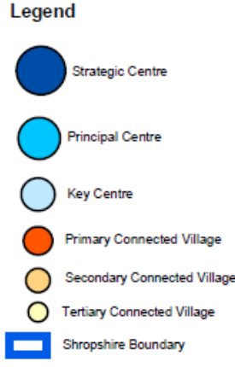
Toward our next Local Plan
Sustainable Growth - Flourishing Shropshire
Draft Community Hierarchy
Conclusion:
Map shows the spatial distribution of communities in the first 6 categories of the hierarchy.

